Slide 1



Clustering using Machine
Learning Techniques
PRESENTED BY :
Tanmay Srivastava
20DCS011
Supervised By :
Dr. Kamlesh Dutta
DEPARTMENT OF COMPUTER SCIENCE AND ENGINEERING
NATIONAL INSTITUTE OF TECHNOLOGY HAMIRPUR
HAMIRPUR (H.P.)-177005

Slide 2

Agenda
1
INTRODUCTION
5
NEW APPROACH
2
OBJECTIVE
6
EVALUATION
3
CLUSTERING ALGORITHMS
7
REFERENCES
4
DATA COLLECTION

Slide 3




INTRODUCTION
In this presentation, we investigate the application of various machine learning clustering algorithms. We explore the efficacy of k-means clustering, DBSCAN, Affinity Propagation, varying epsilon DBSCAN, and a combined approach of k-means clustering and varying epsilon DBSCAN. The clustering results are evaluated using silhouette scores, cluster visualization, and real-world interpretability. The findings provide valuable insights into the strengths and limitations of each algorithm for effective customer segmentation in a mall setting.

Slide 4


OBJECTIVE
The primary objectives of this research are as follows:
1. To apply various machine learning clustering algorithms, including k-means, DBSCAN, Affinity Propagation, and varying epsilon DBSCAN, to segment mall customers.
2. To compare the effectiveness of these algorithms in identifying distinct groups based on their parameters.
3. To provide actionable insights.

Slide 5
Machine Learning
Clustering Algorithms
Machine learning clustering algorithms aim to partition data points into clusters, where each cluster contains data points that are similar to each other and dissimilar to points in other clusters. The following subsections provide an overview of the four clustering algorithms investigated in this research.
K-means Clustering
K-means is a widely used partition-based clustering algorithm that aims to divide data into K clusters. The algorithm iteratively assigns data points to the nearest cluster centroid and recalculates the centroids based on the mean of the assigned points.
Density-Based Spatial Clustering of Applications with Noise (DBSCAN)
DBSCAN is a density-based clustering algorithm that groups data points based on their density in the
feature space. It defines clusters as areas of high density separated by areas of low density, and it can
identify clusters of arbitrary shape and size. DBSCAN requires two parameters: epsilon (ε), which defines
the radius within which to search for neighboring p
Affinity Propagation
Affinity Propagation is a clustering algorithm that does not require specifying the number of clusters (K)
beforehand. Instead, it allows data points to act as exemplars and iteratively exchanges messages between
data points to identify exemplar points that best represent clusters. The algorithm converges to a set of
exemplar points and assigns data points to these exemplars based on similarity.

Slide 6
Data Collection
and Preprocessing
1. Data Source
The data used in this research is collected from a shopping mall and contains information about customers’ demographic attributes and spending behavior.
2. Data Description
The dataset includes the following features:
• Age: The age of the customer.
• Annual Income: The annual income of the customer.
• Spending Score: A score that represents the customer’s spending behavior in the mall. It is assigned based on the customer’s purchasing patterns, frequency of visits, and average spending amount.

Slide 7
3. Data Preprocessing
Data preprocessing is a crucial step to ensure the quality and reliability of the clustering results. We perform the following steps as part of data preprocessing:
3.1 Missing Value Imputation
We check for missing values in the dataset and apply appropriate techniques to handle them. Common methods include mean imputation, median imputation, or using predictive models to fill in missing values.
3.2 Feature Scaling
To ensure that all features contribute equally to the clustering process, we apply feature scaling to standardize the range of the features.
3.3 Outlier Detection
Outliers can significantly impact the clustering process by distorting cluster boundaries. We detect and handle outliers using suitable techniques, such as Z-score, IQR (Interquartile Range), or clustering-based outlier detection methods.

Slide 8
Dataset:
https://datahub.io/machine-learning/mushroom#data
https://github.com/SteffiPeTaffy/machineLearningAZ/blob/master/Machine%20Learning%20A-Z%20Template%20Folder/Part%204%20-%20Clustering/Section%2025%20-%20Hierarchical%20Clustering/Mall_Customers.csv
https://data.world/aliraza/indian-premier-league-2018-batting-and-bowling-data
https://github.com/TrainingByPackt/Data-Science-with-Python/blob/master/Chapter01/Data/Wholesale%20customers%20data.csv

Slide 9
Customer Mall Segmentation Dataset….

Slide 10
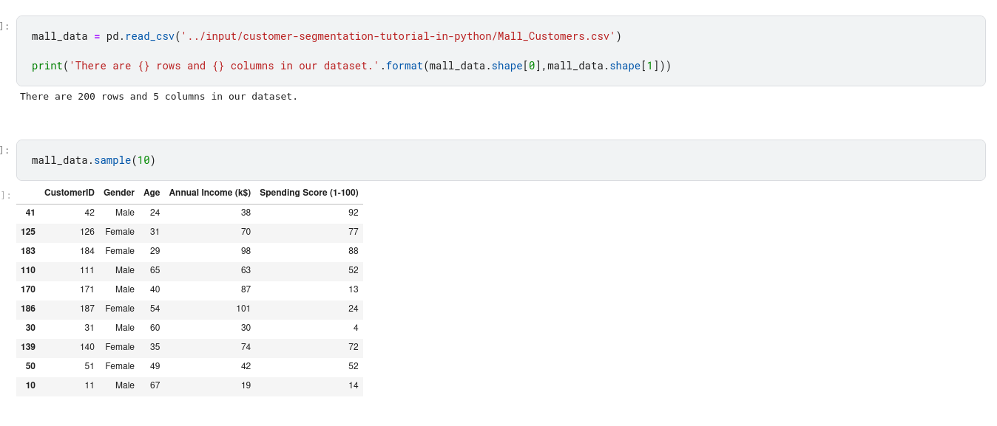
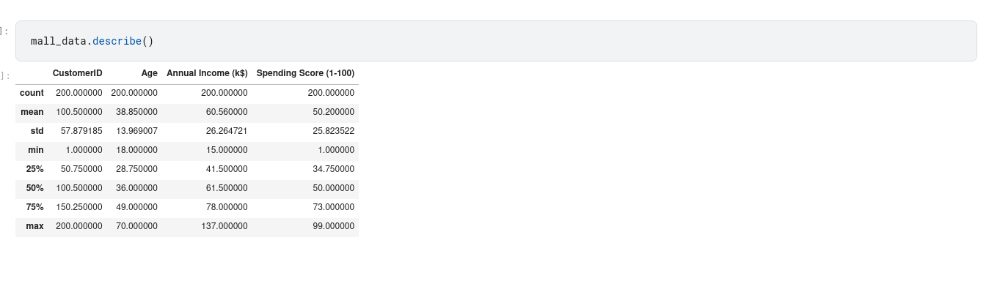

Slide 11
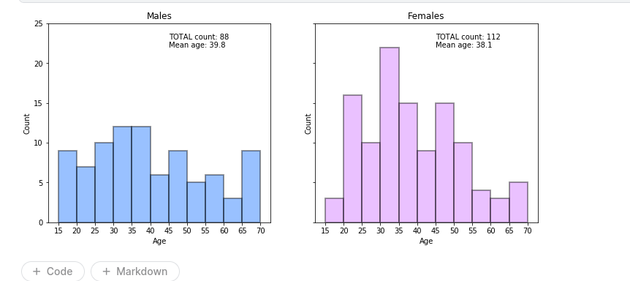

Slide 12
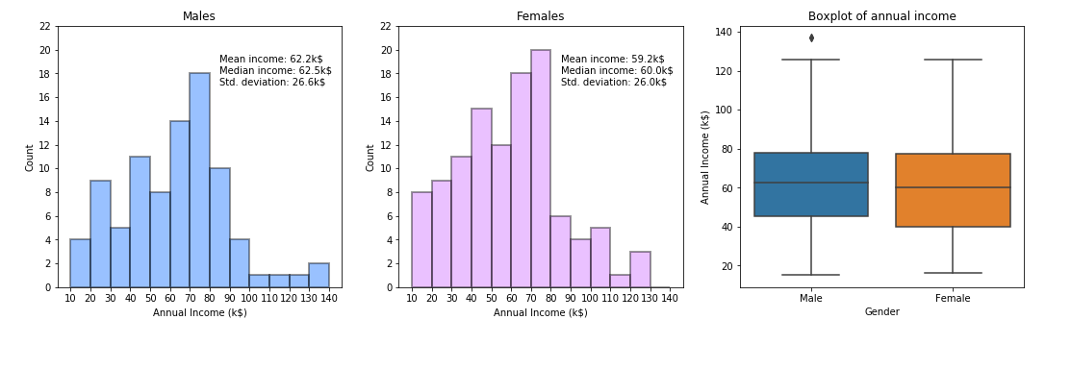

Slide 13
Wholesale Customers Dataset….

Slide 14
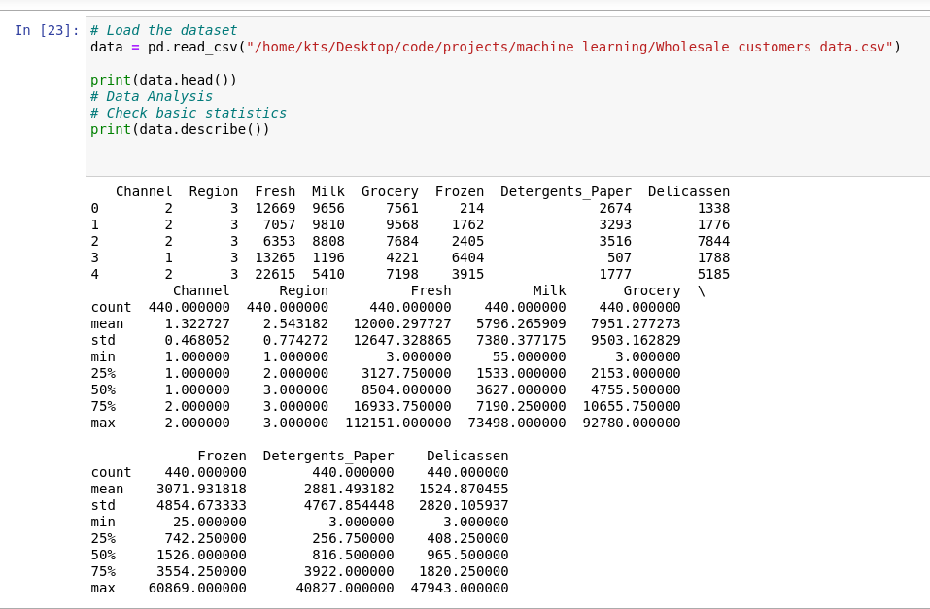

Slide 15
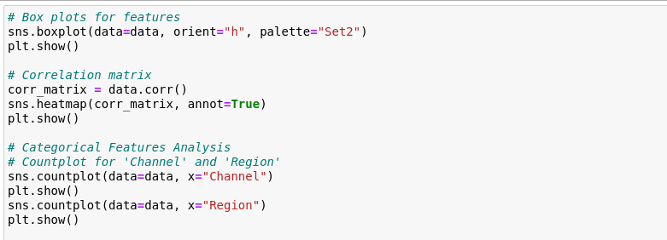

Slide 16
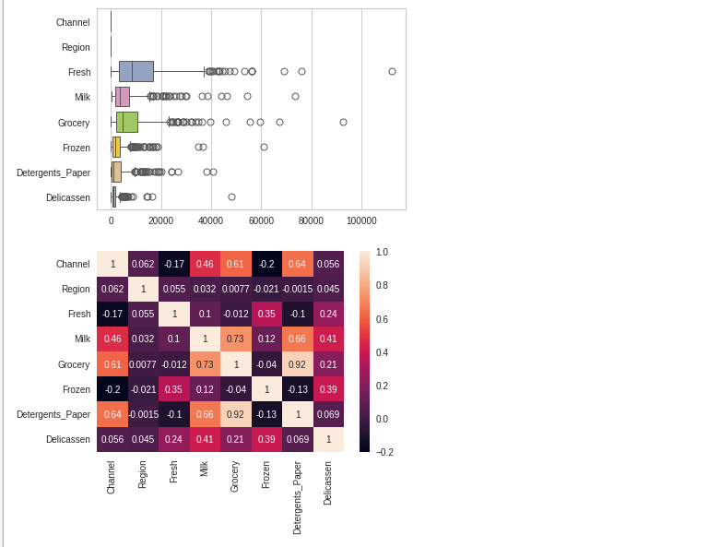

Slide 17
IPL 2018 Dataset….

Slide 18
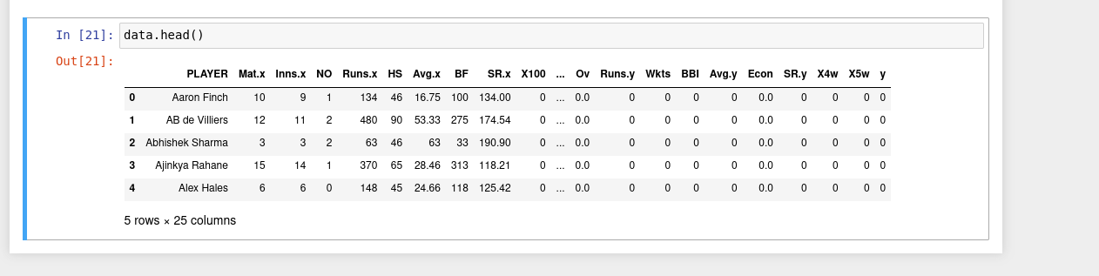
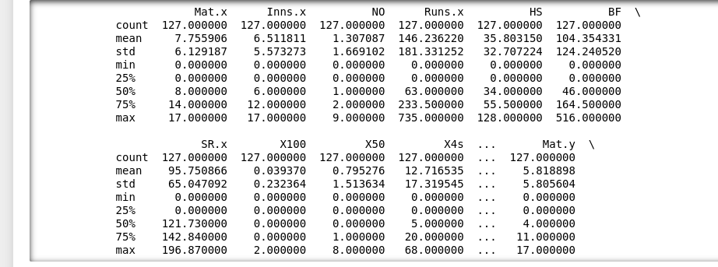
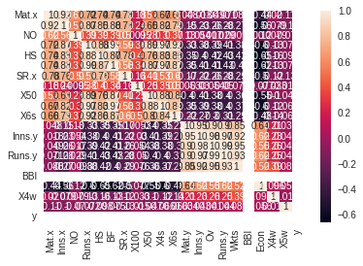

Slide 19
Mushroom Dataset….

Slide 20
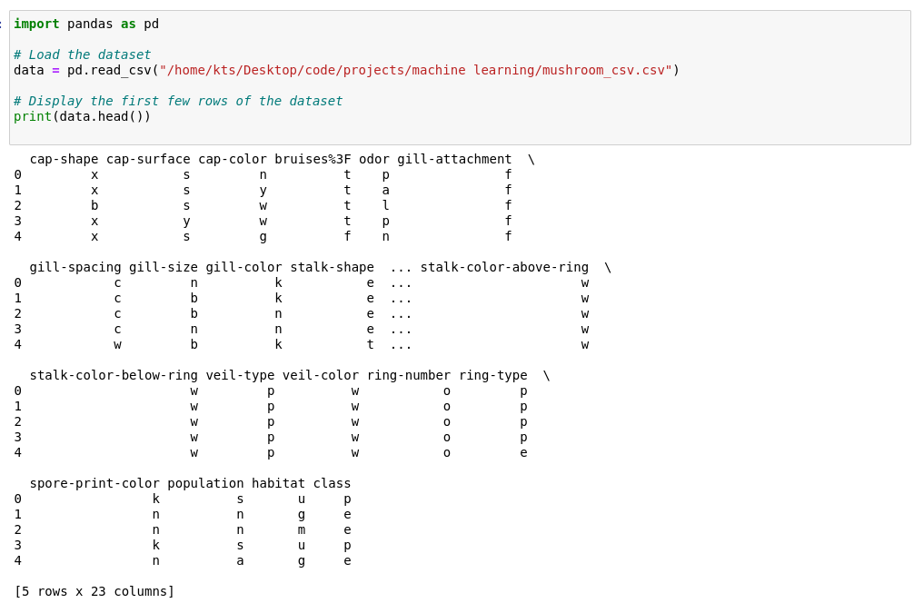

Slide 21
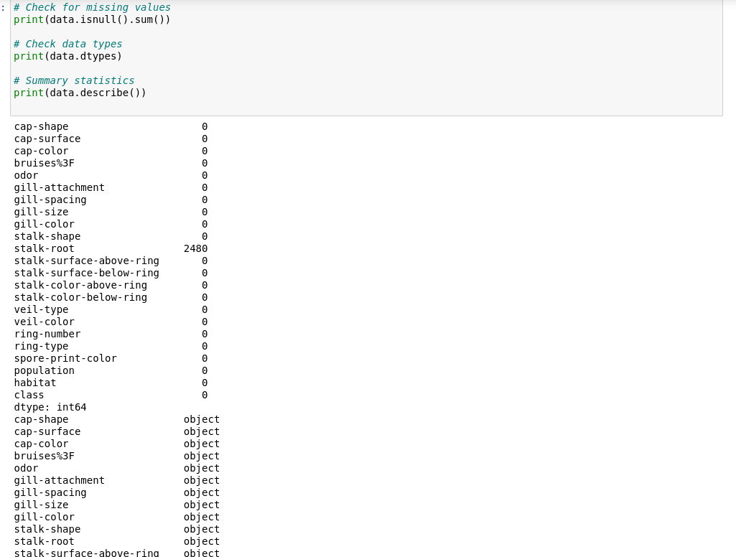

Slide 22
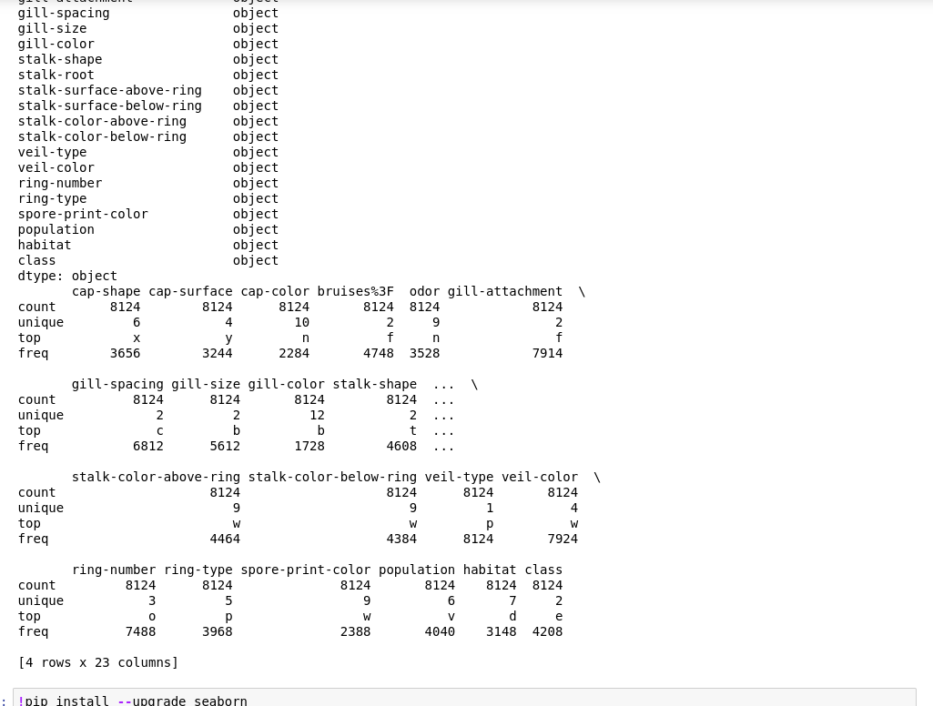

Slide 23
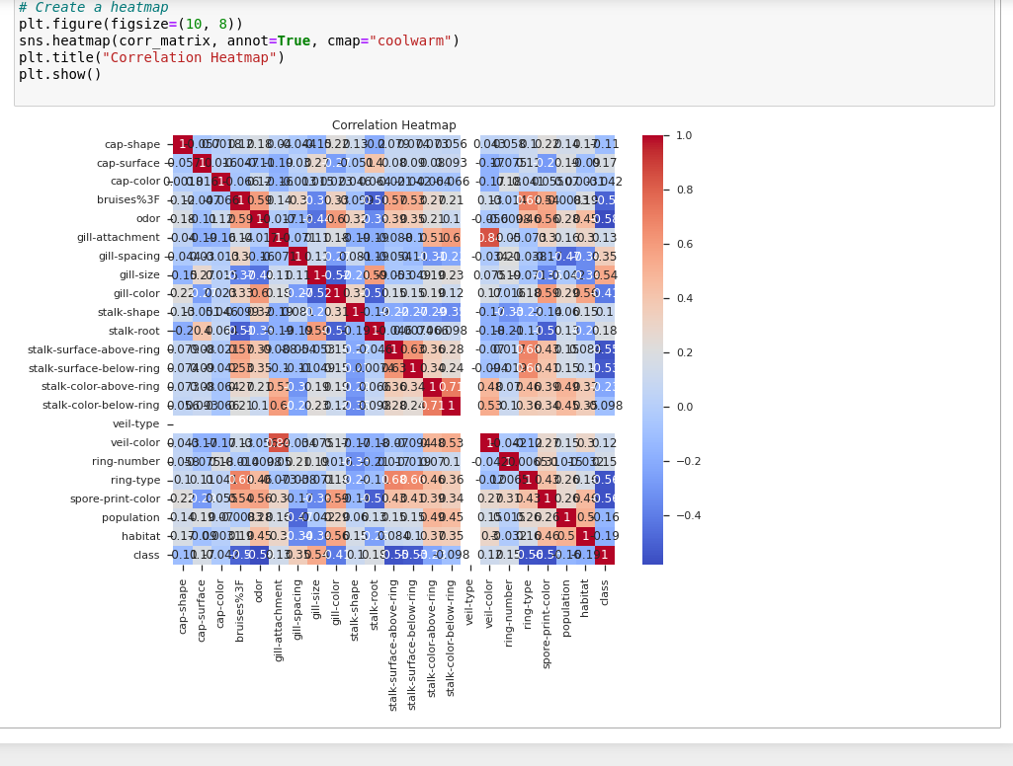

Slide 24
Combined Approach -
k-means and Varying Epsilon DBSCAN
In this section, we propose a novel combined approach that integrates k-means clustering and Varying Epsilon DBSCAN. This hybrid clustering method aims to leverage the strengths of both algorithms to overcome their individual limitations and provide more accurate and robust customer segmentation results.

Slide 25
Integrating k-means and
Varying Epsilon DBSCAN
The integration of k-means and Varying Epsilon DBSCAN involves a two-step process. First, we apply k-means clustering to the dataset to obtain initial cluster centroids. Next, we use these centroids as seed points to initiate Varying Epsilon DBSCAN in the second step. By doing so, we take advantage of k-means’ ability to efficiently handle well-separated clusters and use Varying Epsilon DBSCAN’s adaptability to varying density clusters.
The combined approach allows us to take the best features of both algorithms while mitigating their weaknesses. Additionally, this integration enables us to handle datasets with varying density and non-spherical cluster shapes, which are common in real-world customer segmentation scenarios

Slide 26
Customer Mall Segmentation Dataset….

Slide 27
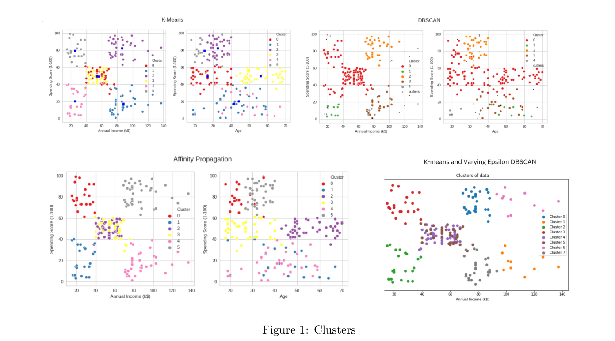
k-means and Varying Epsilon DBSCAN

Slide 28
Wholesale Customers Dataset….

Slide 29
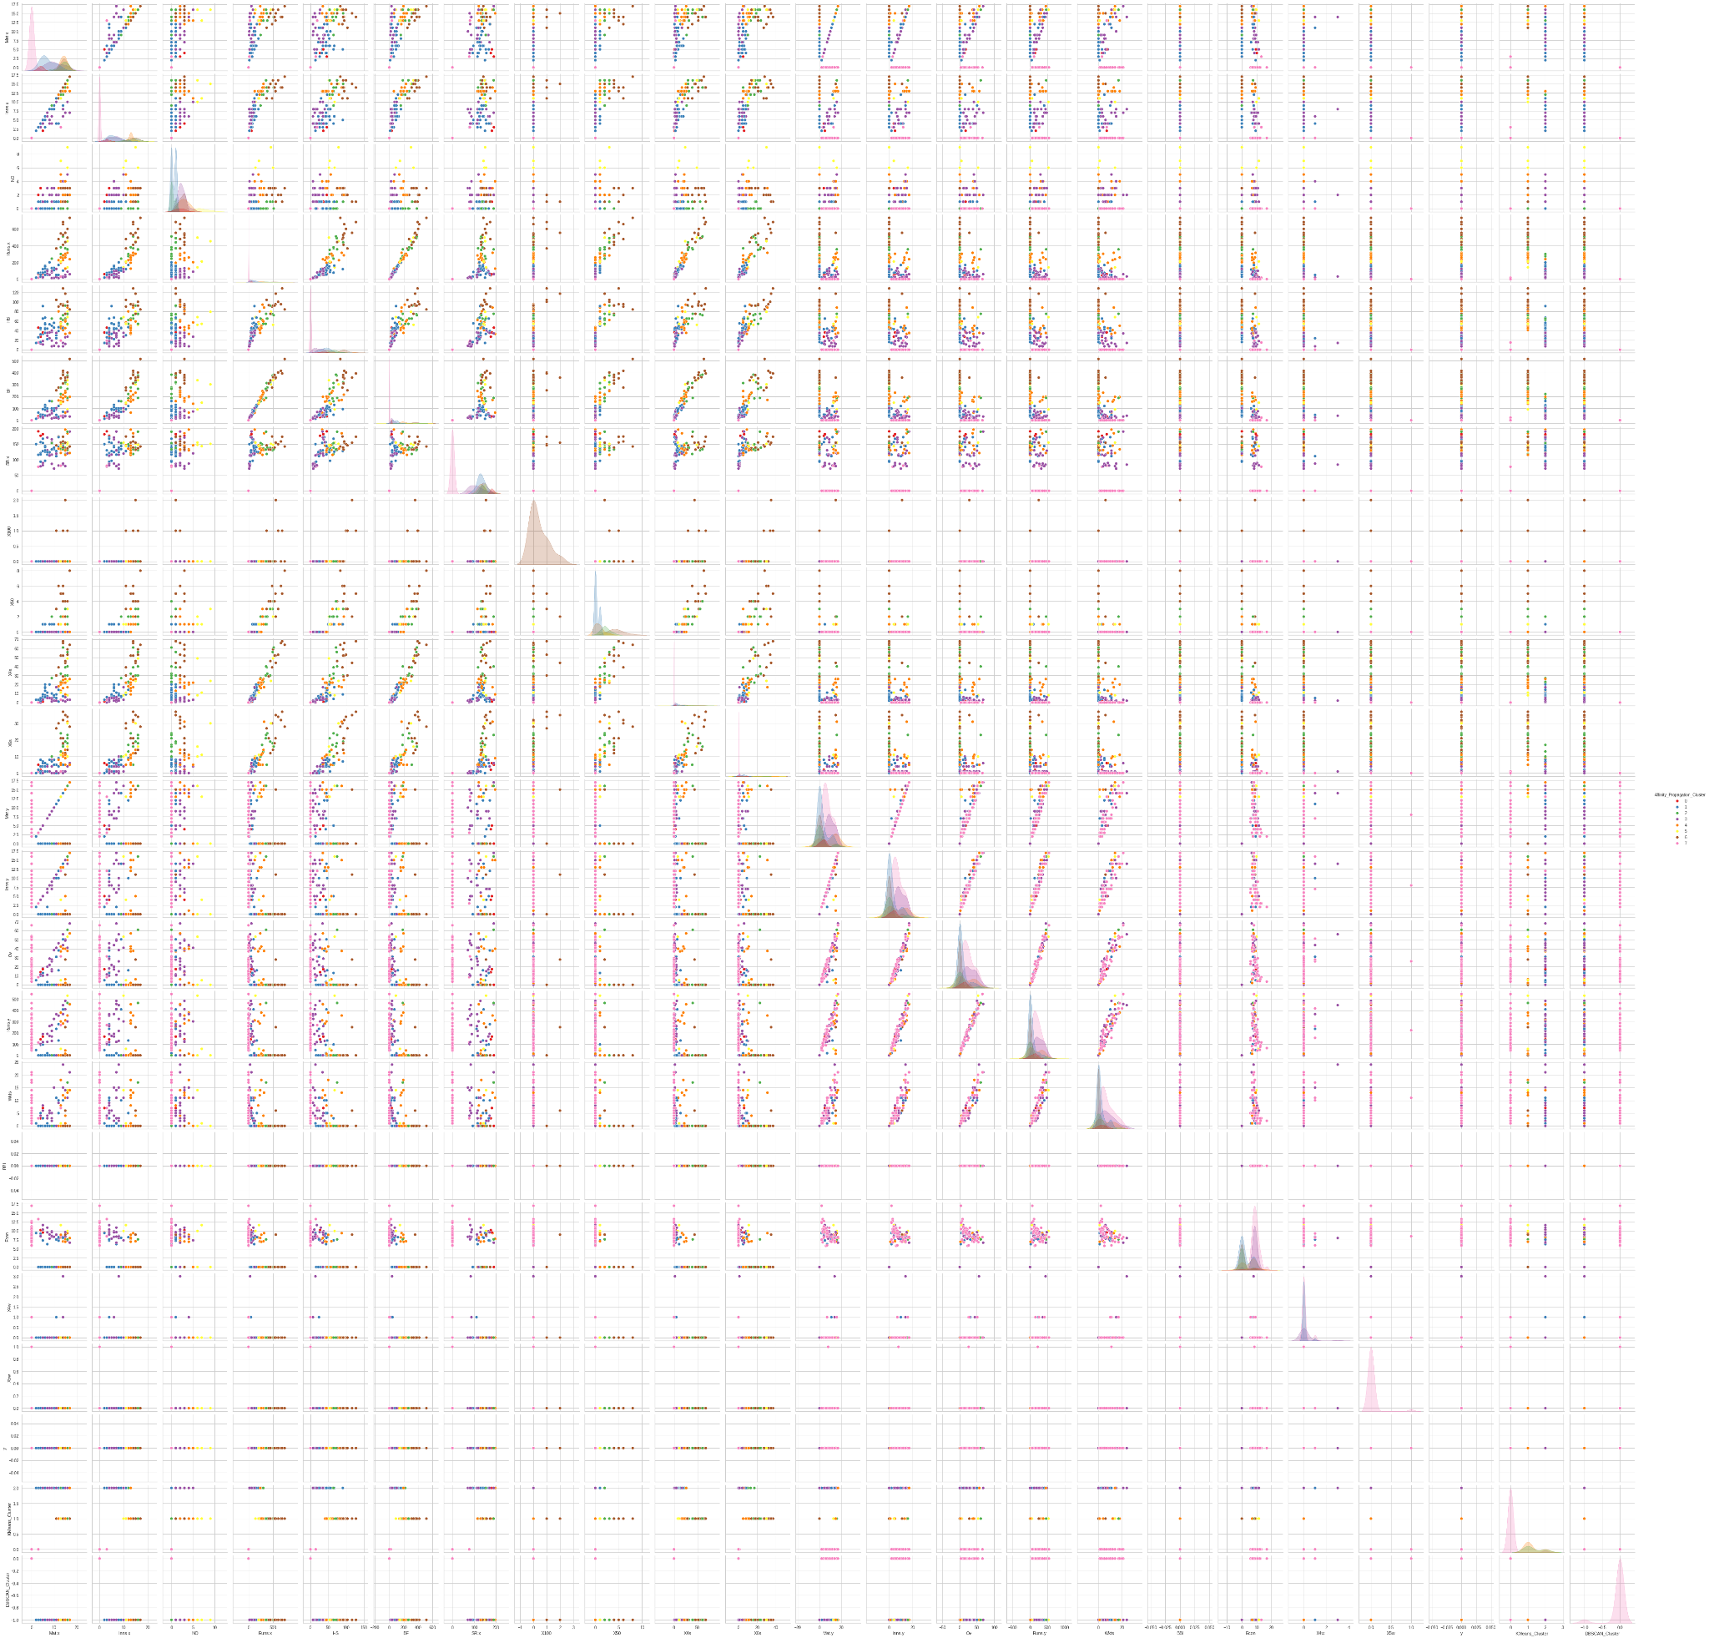

Slide 30
IPL 2018 Dataset….

Slide 31
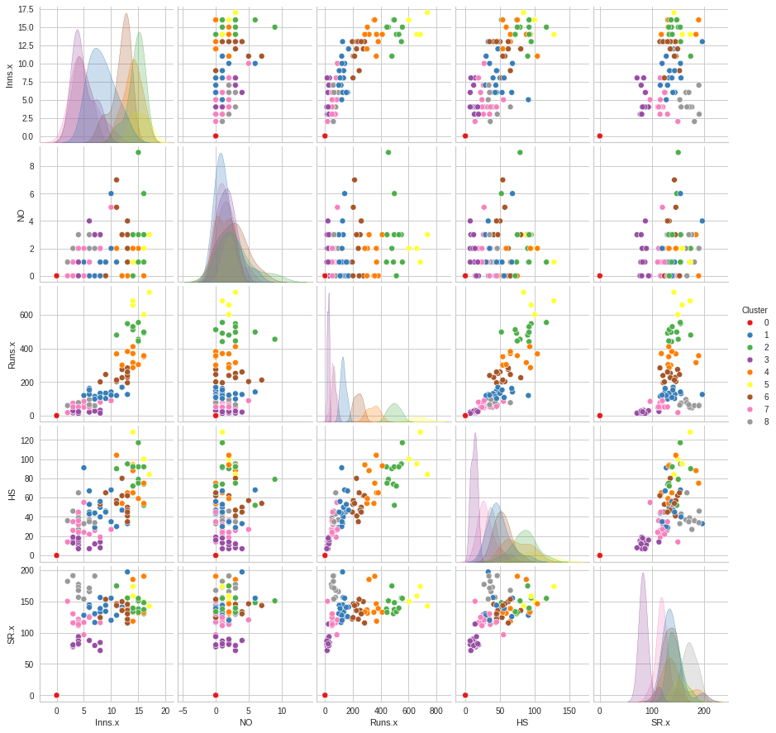

Slide 32
Mushroom Dataset….

Slide 33
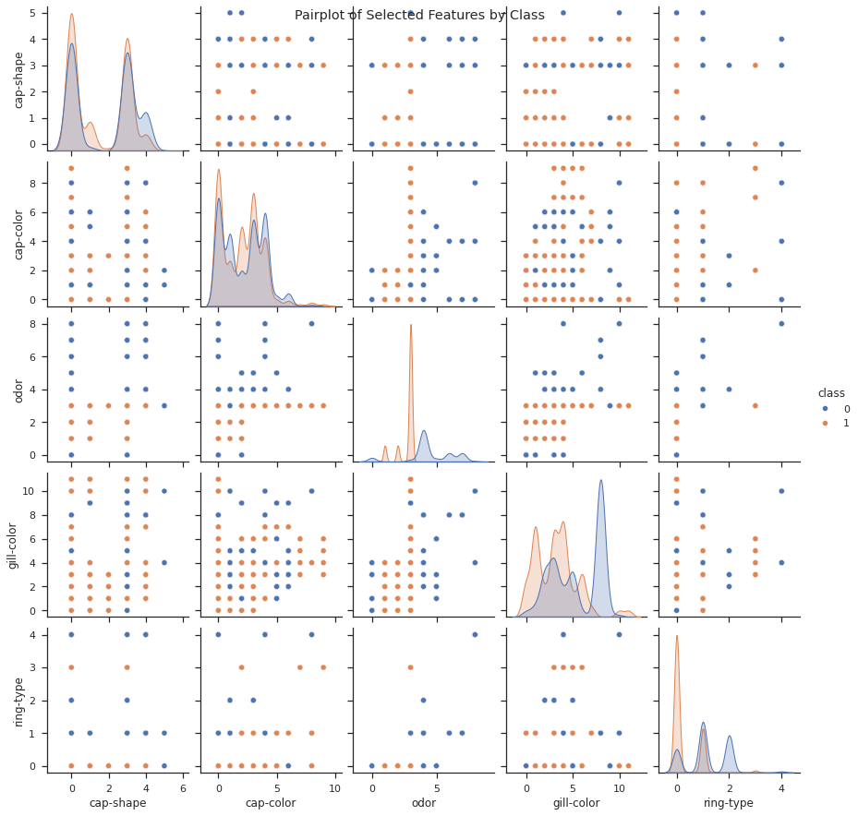

Slide 34
Evaluation and
Comparative Analysis
The evaluation aims to identify the strengths and limitations of each method
in customer segmentation.
Silhouette Scores and Cluster Quality
We calculate the silhouette scores for each clustering method to assess the quality of the clusters. Silhouette scores measure how well-separated the clusters are and provide a quantitative measure of cluster cohesion and separation. Higher silhouette scores indicate better-defined clusters, while negative scores suggest potential overlap or inappropriate clustering.
Visualization of Cluster Separation and Overlapping
We visually compare the clustering results by plotting the clusters in the feature space. Through visual inspection, we analyze how well the clusters separate and whether there is any overlapping between clusters. Additionally, we use scatterplots and color-coding to represent different clusters, enabling easy interpretation of the results.

Slide 35
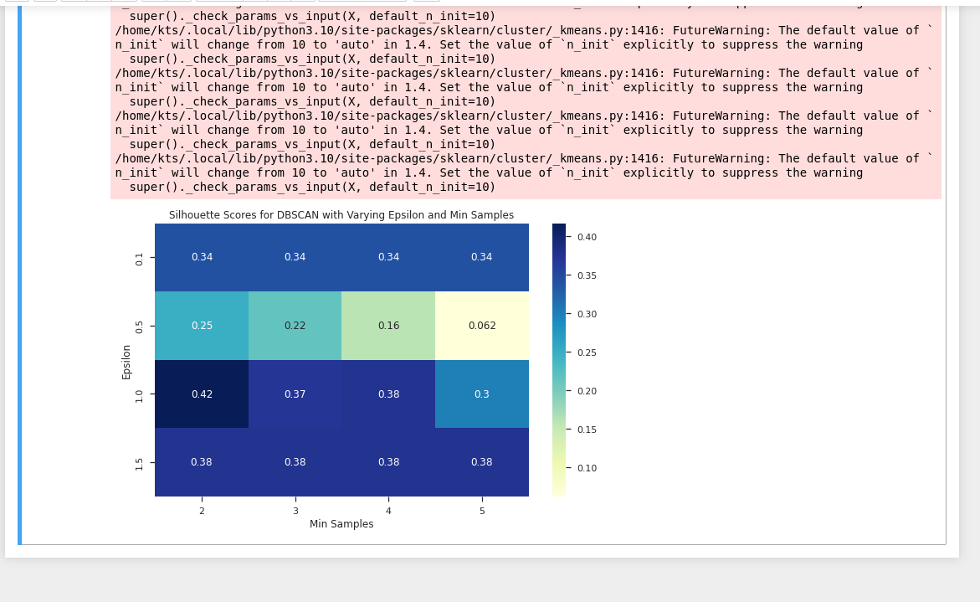
Mushroom Dataset:

Slide 36
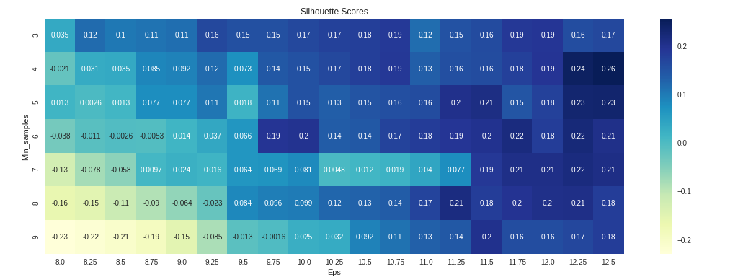
Customer Mall Dataset:

Slide 37
References
[1] Rahmah, N., & Sitanggang, I. S. (Year). Determination of Optimal Epsilon (Eps) Value on DBSCAN Algorithm to Clustering Data on Peatland Hotspots in Sumatra. Journal Name, Volume(Issue), Page Range.
[2] Elbatta, M. N. T. (Year). An improvement for DBSCAN algorithm for best results in varied densities [disertasi]. Gaza (PS): Islamic University of Gaza.

Slide 38

THANK YOU

